Slide 1
Go Profiling and Optimization
Prashant Varanasi - Uber
Notes:
Uber, RPC team, Go client libraries for open source RPC protocol, TChannel, routing and load balancing sidecar.
Maintain Go libraries and build infrastructure
Before Uber, I worked at Google, which is where I started using Go and learnt a lot about the language as well as idioms.
Today’s talk will focus on profiling and optimizing Go. I’m going to cover the tools at a high level, and then we’re going to go hands on with some code.

Slide 2
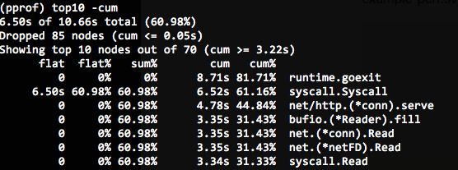
pprof
Inbuilt CPU and heap profiler
Go has powerful profiling built in to the runtime
CPU profiles (stack sampling)
Heap profiles using allocation profiling
and more (block profiles, traces, etc)
Accessible through pprof and runtime packages.
PS: If you’re on OS X, make sure you’re using 10.11 or have run Russ Cox’s kernel fix: rsc.io/pprof_mac_fix

Slide 3
pprof
Inbuilt CPU and heap profiler
Multiple ways to get started with profiling:
Through tests and benchmarks, using the -cpuprofile and -memprofile flags. Build a profile for a benchmark: go test . -bench . -cpuprofile prof.cpu Then analyze the profile: go tool pprof [binary] prof.cpu
import _ net/http/pprof to add /debug/pprof endpoints in your service. Start the profile and analyze the results directly: go tool pprof -seconds 5 http://localhost:9090/debug/pprof/profile
Start the profile from code by calling runtime.StartCPUProfile or runtime.WriteHeapProfile
These profiles are analyzed using go tool pprof

Slide 4
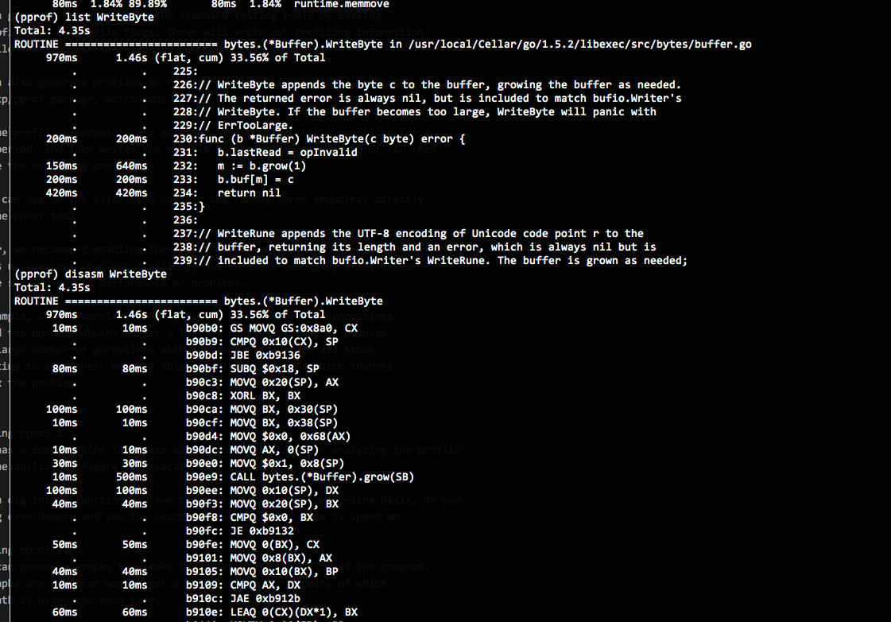
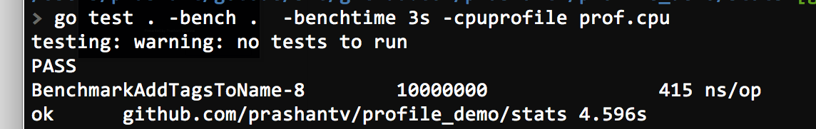
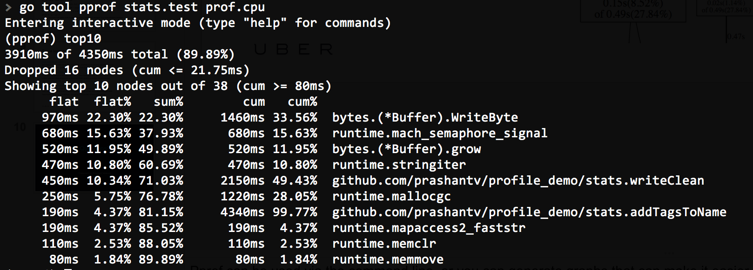
Analyzing profiles
Using the command line interface

Slide 5
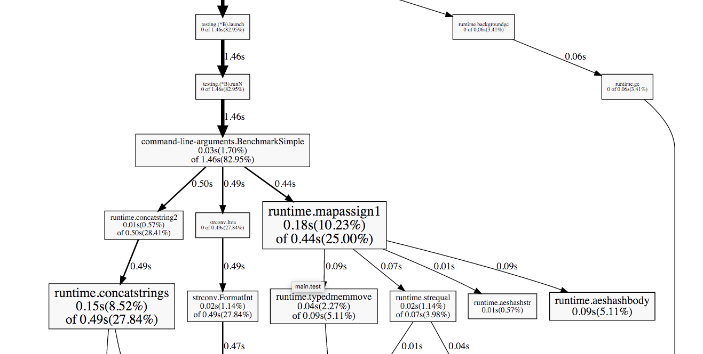
Analyzing profiles
Or using “web” or “svg” to generate a graph which can be easier to follow

Slide 6
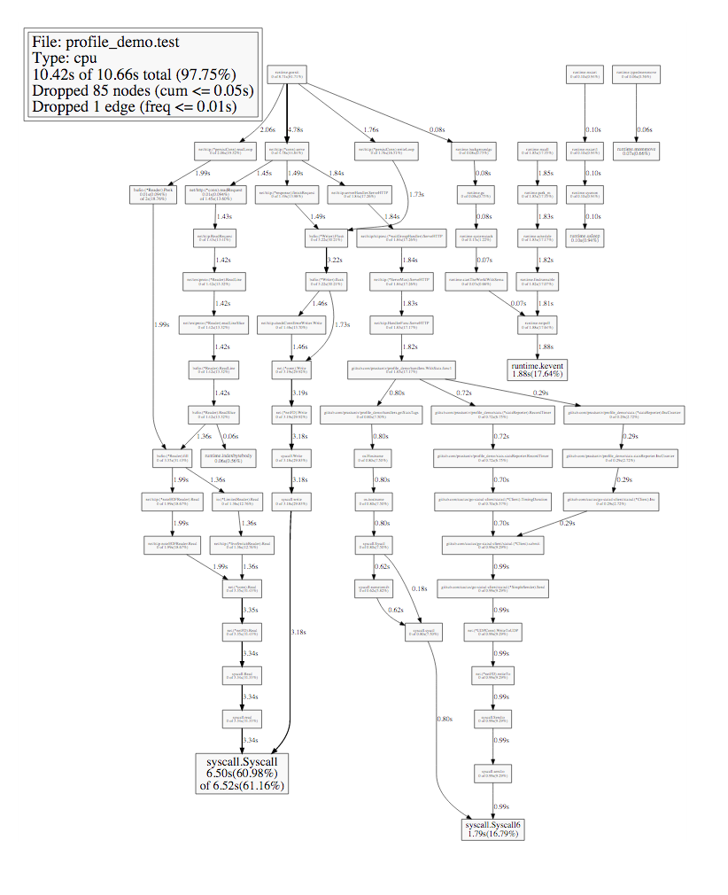
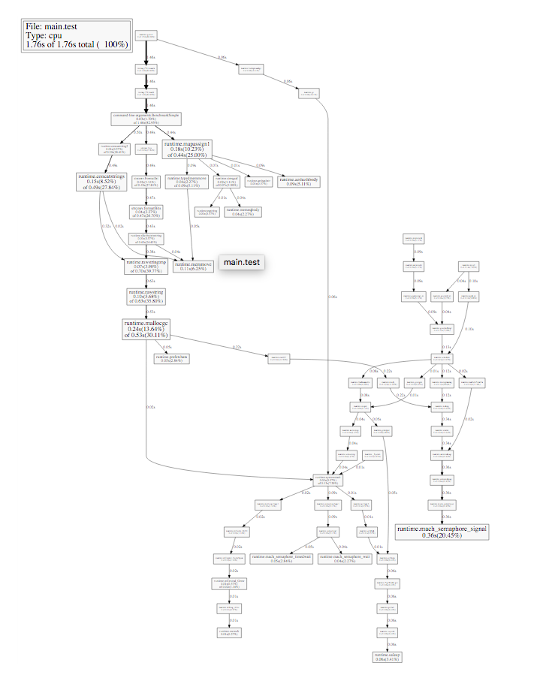
Analyzing profiles
...but not always too easy

Slide 7
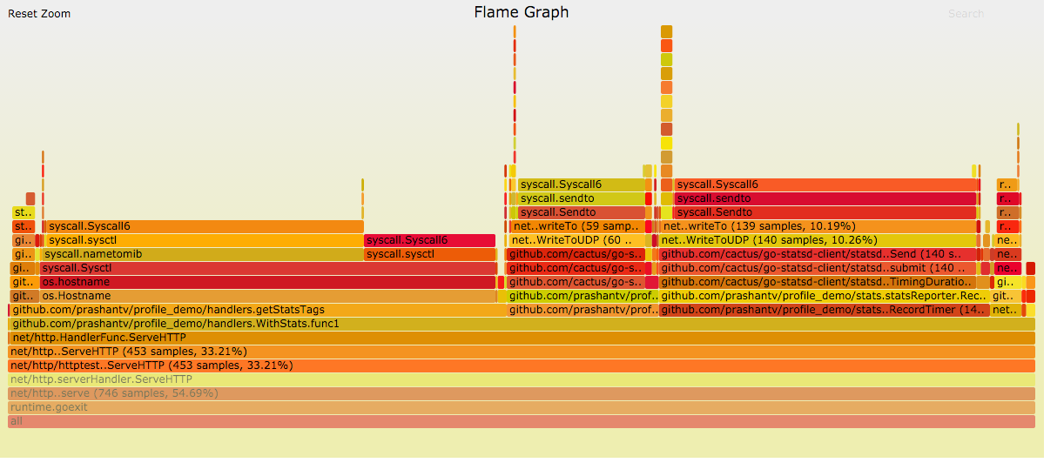
go-torch
Build flame graphs from Go’s pprof format
Flame Graphs are a visualization of profiling data, often used internally with Python and Node
We built go-torch to generate Flame graphs from Go’s pprof output: github.com/uber/go-torch
Notes:
go-torch is a tool we wrote at Uber to generate Flame graphs from the Go pprof output.
It takes advantage of the built in pprof capabilities, but renders the data differently.
We wrote this tool since flame graphs are more familiar to Uber engineers,
as we use them with Node and Python.
In a flame graph, the Y-axis (e.g. go up and down with the cursor?) shows stack depth. The top
box shows the function that was running on the CPU. Everything beneath is the list of callers.
Unlike most graphs,the X axis does represent the passage through time, but is alphabetical.
This is a big point of confusion for users dealing with flame graphs for the first time.
The position of a frame on the X axis does not signify anything.
The width of a single frame shows the total time spent on the CPU. These get wider when
a function is called a lot, or if a function runs for a long time.
Contrary to what you might expect, the colours do not have any meaning. They're randomly
chosen to be warm colours like yellow and red, which makes the graph look like fire..
hence the name FlameGraphs.
You can learn more about flame graphs on Brendan Gregg’s page.
go-torch generates these flame graphs from the same pprof profiles that are generated
through tests or from the pprof HTTP endpoints.

Slide 8
Let’s profile some code
[ Interactive session ]
Let’s profile and optimize a simple HTTP service
Code that we started is available here: https://github.com/prashantv/go_profiling_talk/tree/slow
The faster version of the code is here: https://github.com/prashantv/go_profiling_talk/tree/master
The commit history shows each step of the profiling/optimization https://github.com/prashantv/go_profiling_talk/commits/master

Slide 9
Profiling commands and URLs
Change localhost:9090 to your own host:port, and binary name to your binary
Default pprof endpoint: http://localhost:9090/debug/pprof
go tool pprof -seconds 5 http://localhost:9090/debug/pprof/profile
top10: to show the top 10 functions by time spent only in that function top10 -cum: the top 10 functions by time spent in that function or a function it called. list regex: to show code for functions matching regex disasm regex: to show the disassembly for functions matching regex
go test -bench . -benchmem -cpuprofile prof.cpu -memprofile prof.mem go tool pprof stats.test prof.cpu
go tool pprof -alloc_objects stats.test prof.mem
go-torch -u http://localhost:9090 --time 5
go-torch --binaryname stats.test -b prof.cpu
go build -gcflags=-m . This prints information such as inlined functions, “leaks” and “escapes” (e.g. heap allocated variables)

Slide 10
Some lessons
Don’t prematurely optimize Go makes it very easy to profile your code, whether through local benchmarks or even in production. go-torch can help you find these hot functions.
Avoid allocations in the hot path Write benchmarks for the hot path. Use -benchmem and memory profiles to see where you are allocating and try to avoid them where possible. An allocation means a possible GC, which can mean a latency spike for a request.
Don’t be afraid to look at the disassembly Often, allocations occur or time is spent without it being clear from the code why. Don’t be afraid to dive into the disassembly. Often you’ll find function calls that were hidden (e.g. runtime.convI2E) that explain these allocs/time.

Slide 11
Questions?
Presented by Prashant Varanasi (@prashantv)
Uber

